Slide 1

Geometry
Unit 3, Lesson 4 Consecutive Angles Volume 1, pg. 144

Slide 2


Benchmark
MA.912.GR.1.1
Prove relationships and theorems about lines and angles. Solve mathematical and real-world problems involving postulates, relationships, and theorems of lines and angles.
volume 1, pg. 144

Slide 3
Integrated Mathematical Thinking and Reasoning Standards
MA.K12.MTR.1.1 Actively participate in effortful learning both individually and collectively.
MA.K12.MTR.4.1 Engage in discussions that reflect on the mathematical thinking of self and others.
MA.K12.MTR.5.1 Use patterns and structure to help understand and connect mathematical concepts.
MA.K12.MTR.6.1 Assess the reasonableness of solutions.
volume 1, pg. 144

Slide 4

Learning Targets
I can determine the relationships of consecutive exterior and interior angles.
I can solve problems that involve angles formed by parallel lines intersected by a transversal.
volume 1, pg. 144

Slide 5

Warm-Up
volume 1, pg. 144

Slide 6
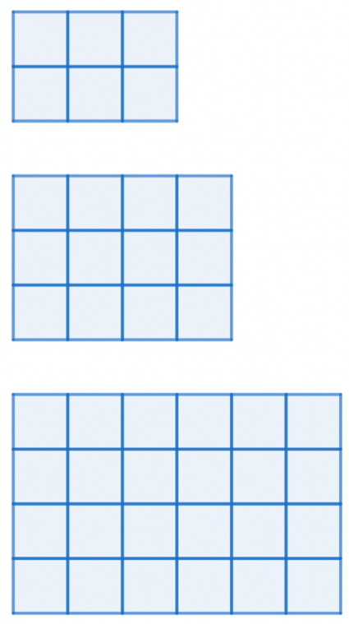
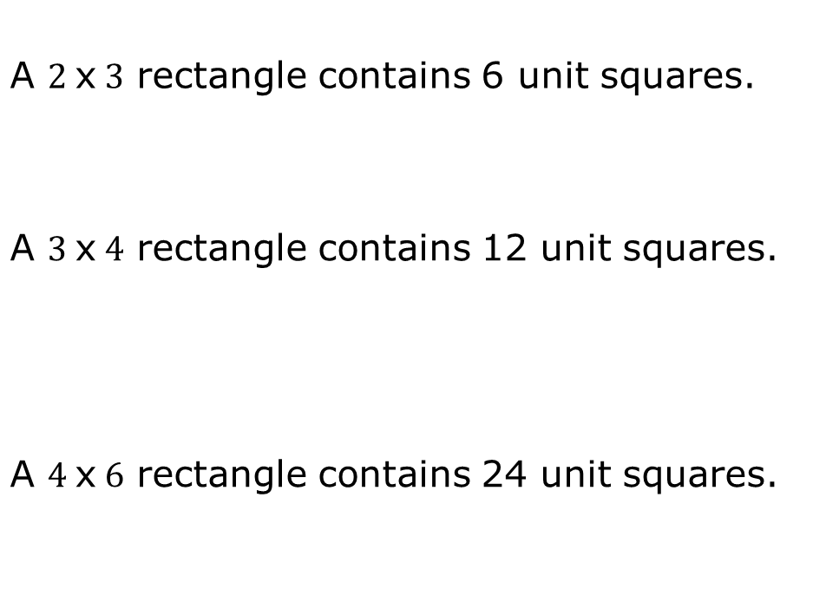
3.4.1 Warm-Up: Squares in Rectangles
Three rectangles and their descriptions are shown.
A $2$x$3$ rectangle contains 6 unit squares.
A $3$x$4$ rectangle contains 12 unit squares.
A $4$x$6$ rectangle contains 24 unit squares.
volume 1, pg. 144

Slide 7
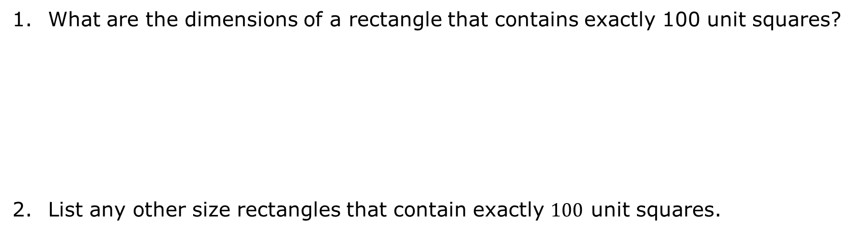
What are the dimensions of a rectangle that contains exactly 100 unit squares?
List any other size rectangles that contain exactly $100$ unit squares.
volume 1, pg. 144

Slide 8

Collaboration
volume 1, pg. 145

Slide 9

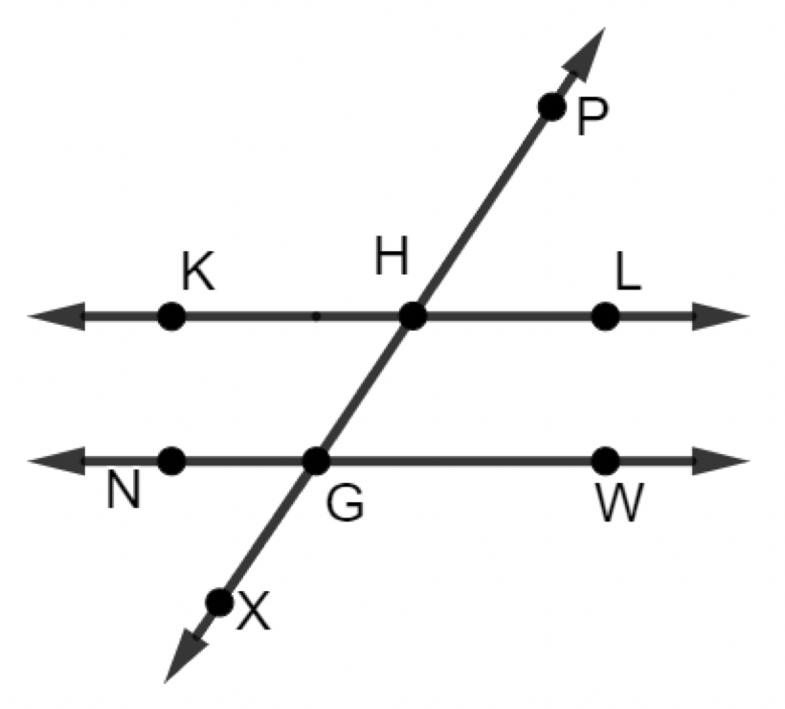
3.4.2 Collaboration: Consecutive Interior and Exterior Angles
$\overset{⃡}{KL} ||\overset{⃡}{NW}$ where $\overset{⃡}{XP}$ is a transversal.
volume 1, pg. 145

Slide 10
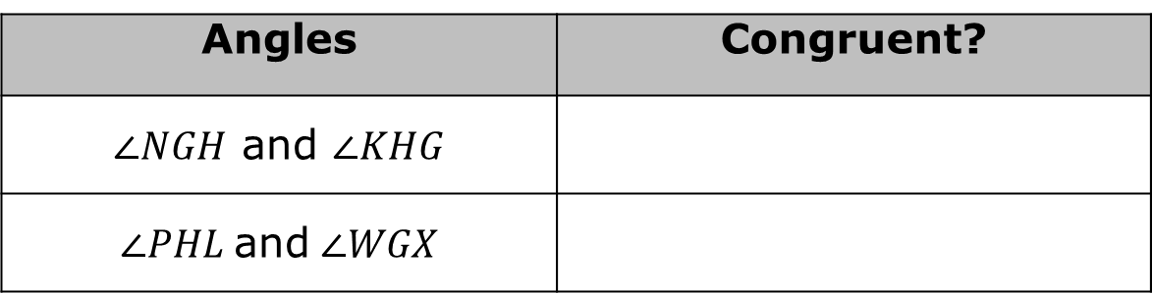
Work with your partner to determine if each pair of angles could be congruent by using corresponding, alternate exterior, alternate interior, or vertical angles.
Work with your partner to determine which pair of angles in the table could be described as consecutive interior angles.
Angles | Congruent?
$∠NGH$ and $∠KHG$
$∠PHL$ and $∠WGX$
volume 1, pg. 145

Slide 11
Name another pair of consecutive interior angles.
Work with your partner to write a conjecture about the relationship that is true for consecutive interior angles.
Ask another classmate for their conjecture about consecutive interior angles. Record their conjecture and write your summary of their reason. You are the only person who should write in the first two columns of the table. Have the person initial next to your summary stating that your summary was correct.
Conjecture | My Summary of Their Reason | Initials
volume 1, pg. 145

Slide 12
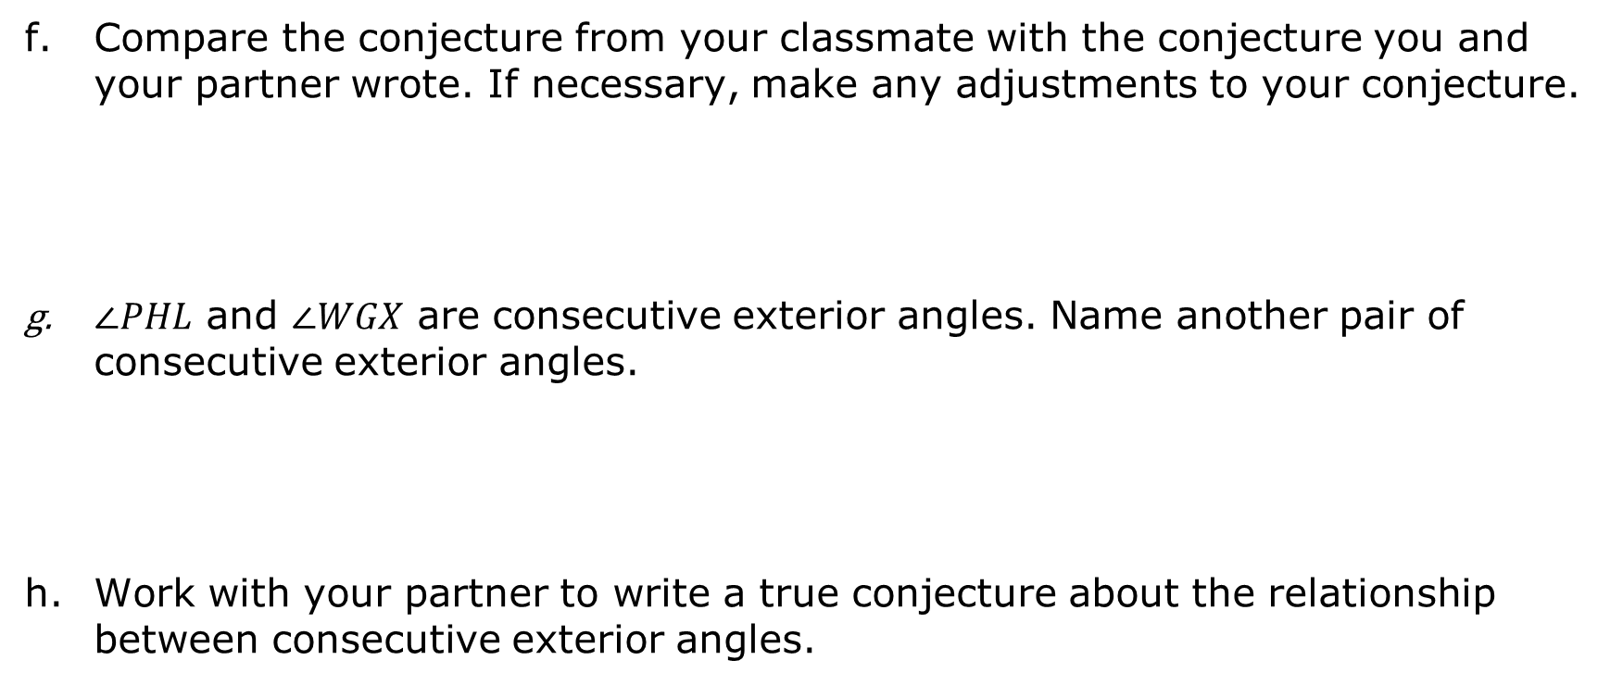
Compare the conjecture from your classmate with the conjecture you and your partner wrote. If necessary, make any adjustments to your conjecture.
$∠PHL$ and $∠WGX$ are consecutive exterior angles. Name another pair of consecutive exterior angles.
Work with your partner to write a true conjecture about the relationship between consecutive exterior angles.
volume 1, pg. 146

Slide 13
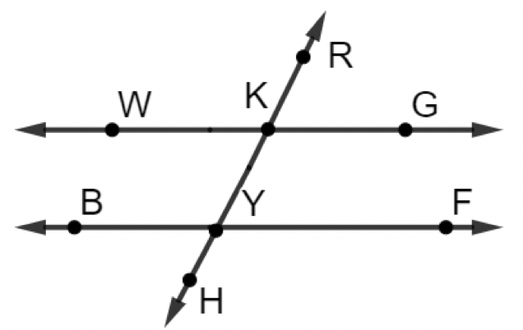
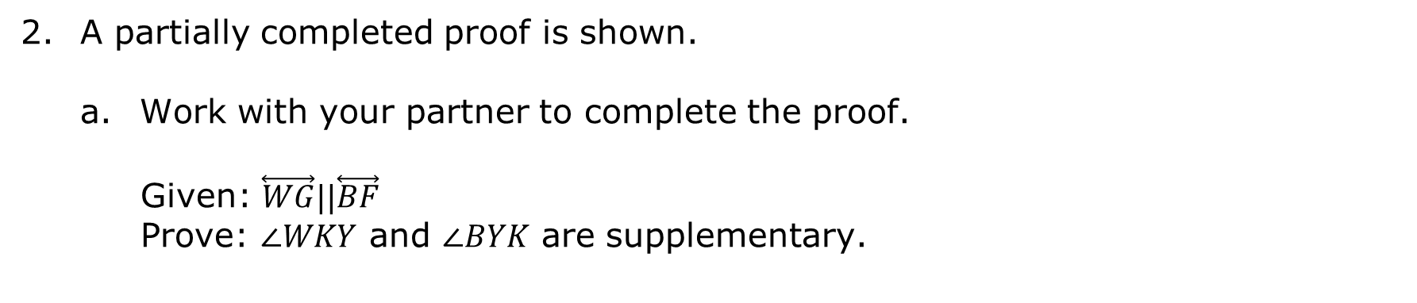
A partially completed proof is shown.
Work with your partner to complete the proof.
Given: $\overset{⃡}{WG}||\overset{⃡}{BF}$
Prove: $∠WKY$ and $∠BYK$ are supplementary.
volume 1, pg. 146

Slide 14
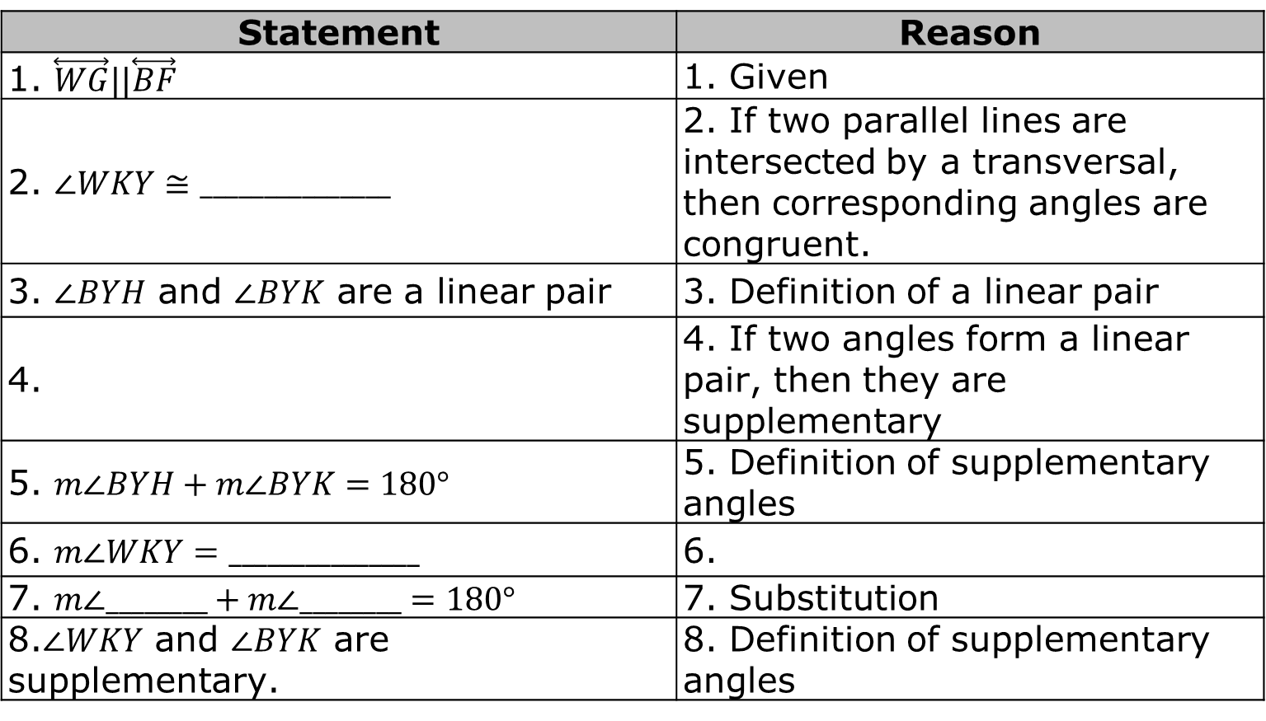
Statement | Reason
1. $\overset{⃡}{WG}||\overset{⃡}{BF}$ | 1. Given
2. $∠WKY≅_______________$ | 2. If two parallel lines are intersected by a transversal, then corresponding angles are congruent.
3. $∠BYH$ and $∠BYK$ are a linear pair | 3. Definition of a linear pair
4. | 4. If two angles form a linear pair, then they are supplementary
5. $m∠BYH+m∠BYK=180°$ | 5. Definition of supplementary angles
6. $m∠WKY=_______________$ | 6.
7. $m∠________+m∠________=180°$ | 7. Substitution
8.$∠WKY$ and $∠BYK$ are supplementary. | 8. Definition of supplementary angles
Check your proof with another classmate. If necessary, make any adjustments.
volume 1, pg. 146

Slide 15
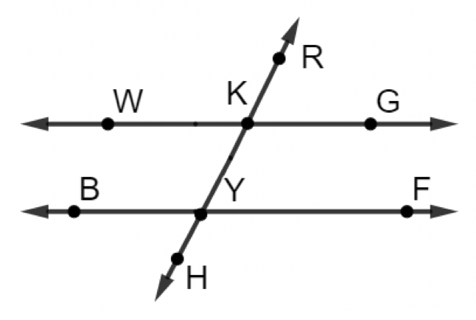

Work with your partner to complete the proof.
Given: $\overset{⃡}{WG}||\overset{⃡}{BF}$
Prove: $∠RKG$ and $∠FYH$ are supplementary.
volume 1, pg. 147

Slide 16
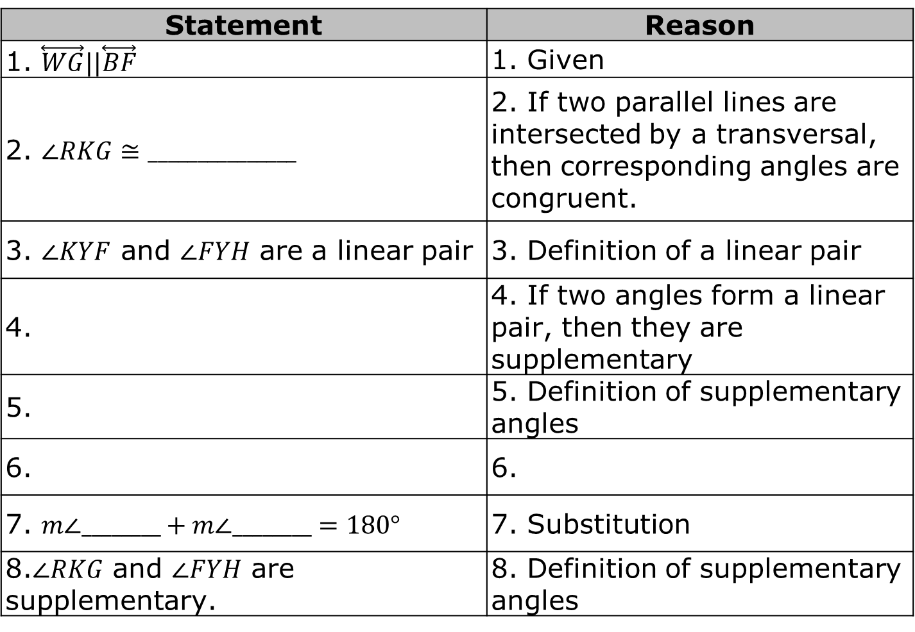
Statement | Reason
1. $\overset{⃡}{WG}||\overset{⃡}{BF}$ | 1. Given
2. $∠RKG≅_______________$ | 2. If two parallel lines are intersected by a transversal, then corresponding angles are congruent.
3. $∠KYF$ and $∠FYH$ are a linear pair | 3. Definition of a linear pair
4. | 4. If two angles form a linear pair, then they are supplementary
5. | 5. Definition of supplementary angles
6. | 6.
7. $m∠________+m∠________=180°$ | 7. Substitution
8.$∠RKG$ and $∠FYH$ are supplementary. | 8. Definition of supplementary angles
volume 1, pg. 147

Slide 17

Mistakes can be an opportunity to learn.
What mistakes did you make in the first proof that helped you in the second proof?
volume 1, pg. 147

Slide 18

If you did not make a mistake in the first proof, describe how the proofs were similar.
Consecutive Interior Angles Theorem
If two parallel lines are intersected by a transversal, then interior angles on the same side of the transversal are supplementary.
Consecutive Exterior Angles Theorem
If two parallel lines are intersected by a transversal, then exterior angles on the same side of the transversal are supplementary.
volume 1, pg. 147

Slide 19

Guided Practice
volume 1, pg. 148

Slide 20

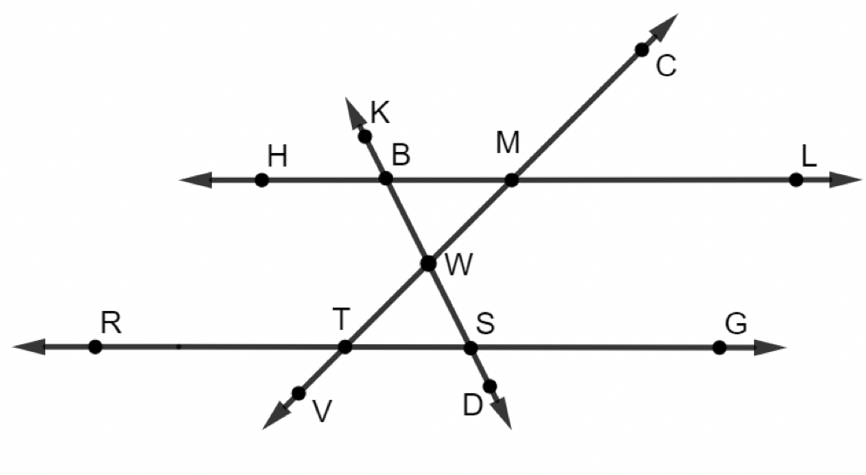
3.4.3 Guided Practice: Angles in Parallel Lines
$\overset{⃡}{HL} ||\overset{⃡}{RG}$ where $\overset{⃡}{CV}$ and $\overset{⃡}{KD}$ are transversals with $m∠KBM=117°$ and $m∠VTS=134°$.
volume 1, pg. 148

Slide 21
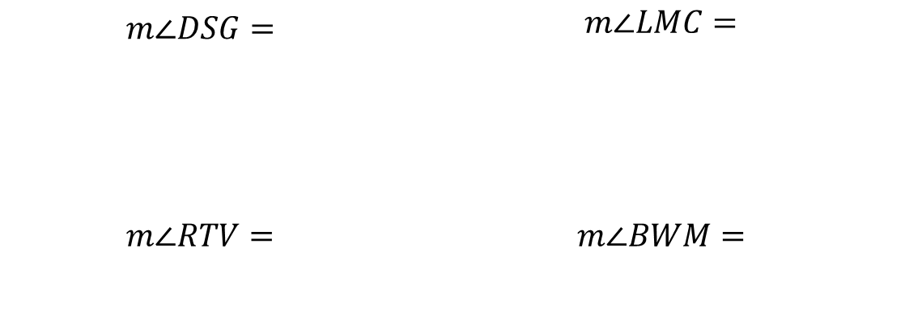
Determine the measurement of each angle.
$$m∠DSG=$$ | $$m∠LMC=$$
$$m∠RTV=$$ | $$m∠BWM=$$
volume 1, pg. 148

Slide 22
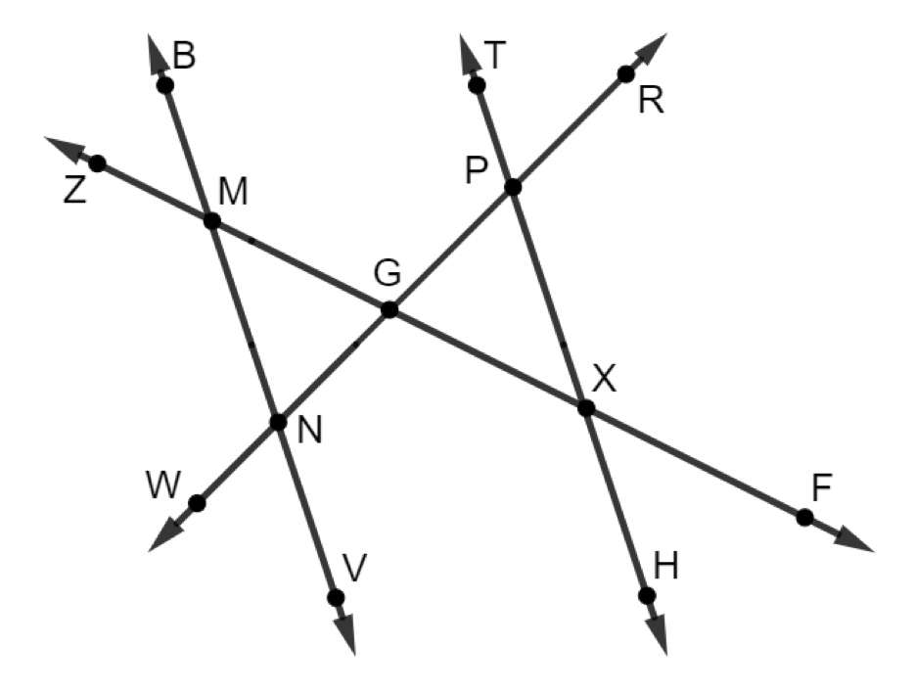

In the figure shown, $\overset{⃡}{BV} ∥ \overset{⃡}{TH}$ , $m∠GXH=(5\left(2x−1\right))°$, $m∠GMN=(4x−11)°$, $m∠XPG=(3y−8)°$, and $m∠VNG=(7y−52)°$.
Find the value of $x$.
Find the value of $y$.
volume 1, pg. 148

Slide 23

Wrap-Up
volume 1, pg. 149

Slide 24
3.4.4 Wrap-Up: Reflection
Rate your confidence in solving problems using these angle pairs.
I can solve number problems involving…. | I am an expert and could help others. | I can hold my own. | I am getting there. | I would like more help or practice.
Congruent Supplements
Congruent Complements
Vertical Angles
Consecutive Interior Angles
volume 1, pg. 149

Slide 25
I can solve number problems involving…. | I am an expert and could help others. | I can hold my own. | I am getting there. | I would like more help or practice.
Consecutive Exterior Angles
Alternate Interior Angles
Alternate Exterior Angles
Corresponding Angles
volume 1, pg. 149

